Slide 1
ISMB Tutorial Prep

Slide 2
Quantum-enabled multi-omics analysis
Friday, July 12, 2024
9 AM – 6 PM EDT
Palais des congrès de Montréal
https://www.iscb.org/ismb2024/programme-schedule/tutorials#ip4

Slide 3
Session Plan
Session I: Quantum Information basics, states, gates, circuits, etc.
Session II: Qiskit basics and introduction
Session III: Analyze multi-omics data (TCGA RNAseq or scRNAseq) with classical methods
Session IV: Setup qiskit and run a QML algorithm for classifying disease sub-types
Session V: Summarize the tutorial and interactive Q&A

Slide 4
Session Plan
Time | Session | Title
0900 - 1000 | I | Quantum Information & Fundamentals
1000-1045 | I | IBM Quantum setup & Introduction to Qiskit
1045-1100 | - | Coffee Break
1100-1200 | II | Introduction to Quantum circuits
1200-1300 | II | Variational Quantum Algorithms & Machine Learning
1300-1400 | - | Lunch
1400-1430 | III | Single-cell RNAseq Data & Classical Machine Learning
1430-1600 | III | Quantum Machine Learning concepts and applications in single-cell RNAseq data.
1600-1615 | - | Coffee Break
1615-1700 | IV | Design and Implementation of Quantum Machine Learning in single-cell RNAseq data.
1700-1800 | V | Interactive Q&A

Slide 5
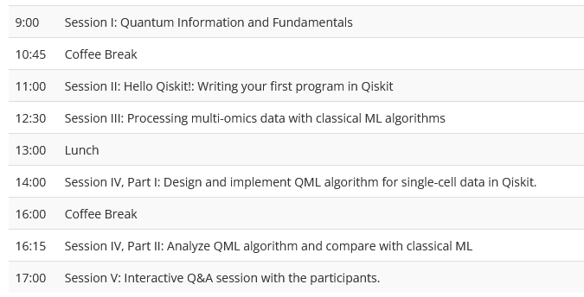
Schedule
9-10: Quantum Fundamentals, 25 slides
10:05-10:45: Qiskit demo, setup, IBM Quantum accounts
11-11:55: Contd.. Qiskit demo, circuits, transpilation
12-12:30: VQA and QML intro, 16 slides
2-2:30: Data and classical ML for multi-omics analysis
2:30-4: Problem setup in Quantum and code walkthrough Feature maps, COBYLA/SPSA, etc.
Show QSVC, VQC, QNN
4:15-5: QML applications on the data and demo
5-6: Interactive Q&A

Slide 6

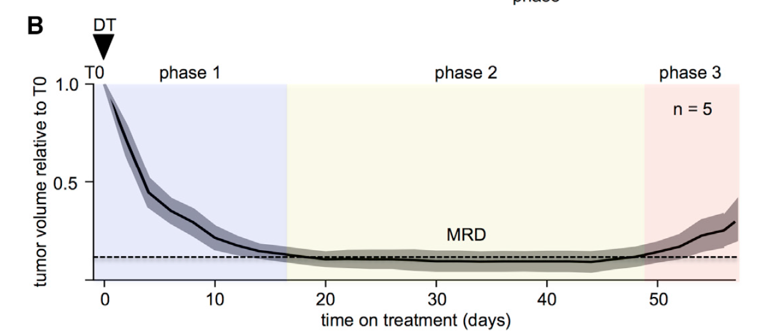
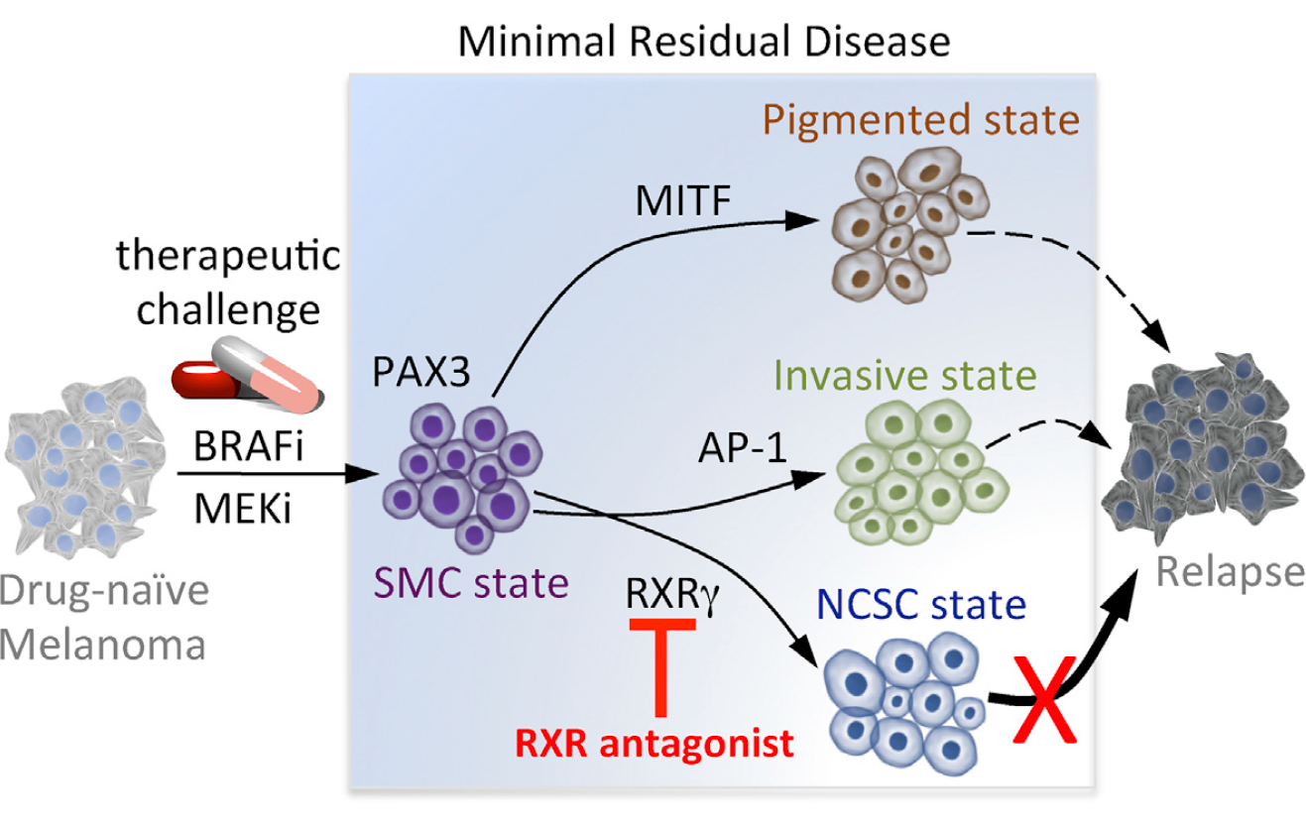
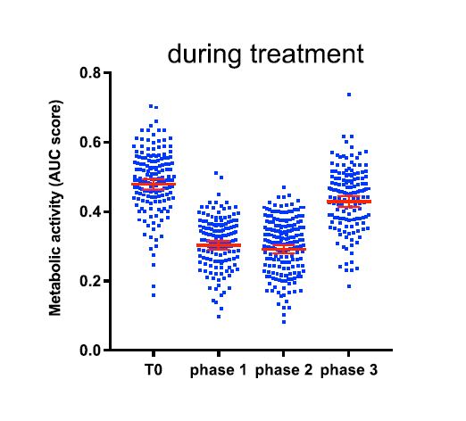

Slide 7
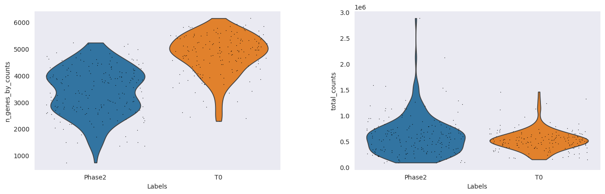
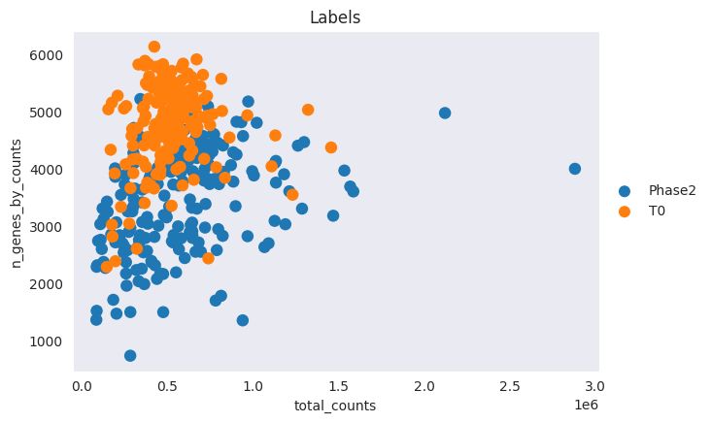
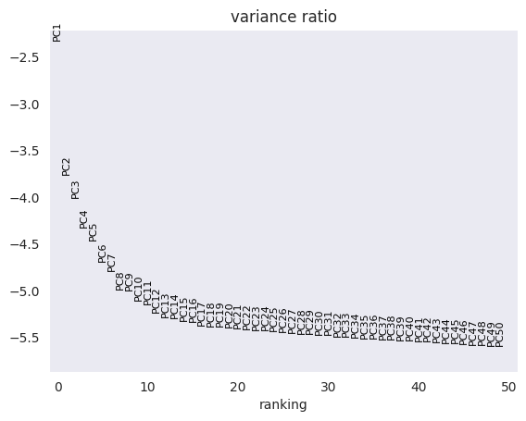
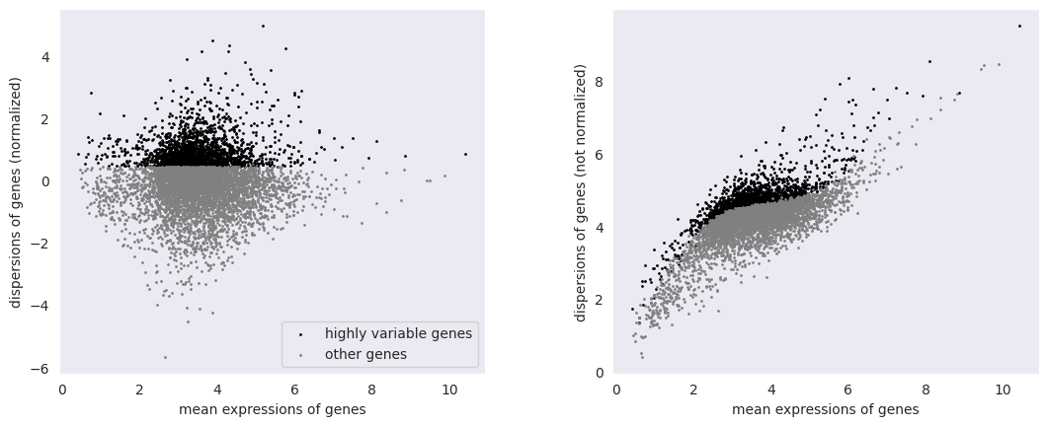
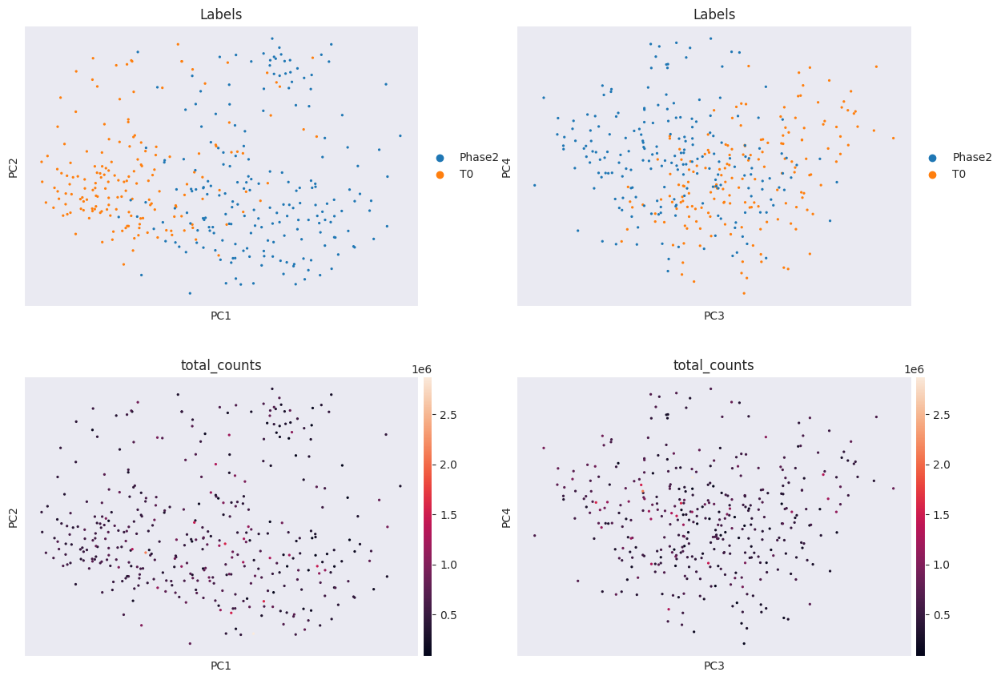
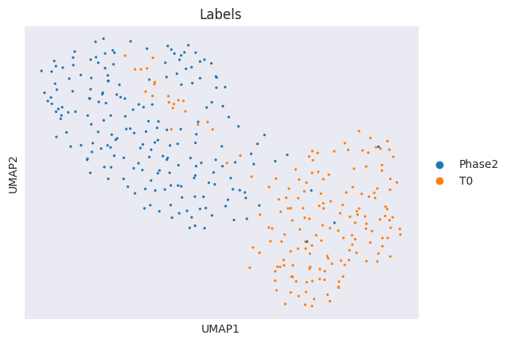
# of cells: 675
# of genes: 7263
Select T0
&
Phase2 cells
Filter for
mt, ribo, & hb genes
# of cells: 371
# of genes: 6910

Slide 8
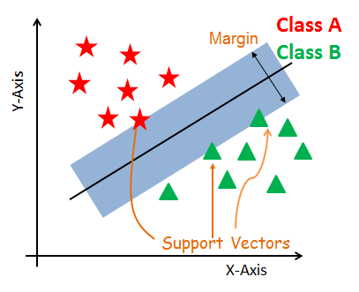

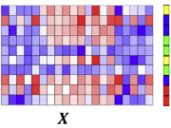
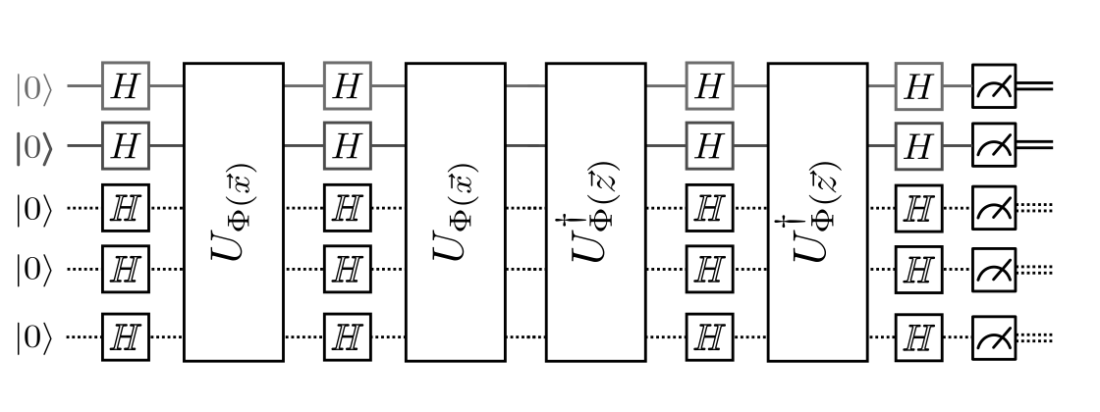
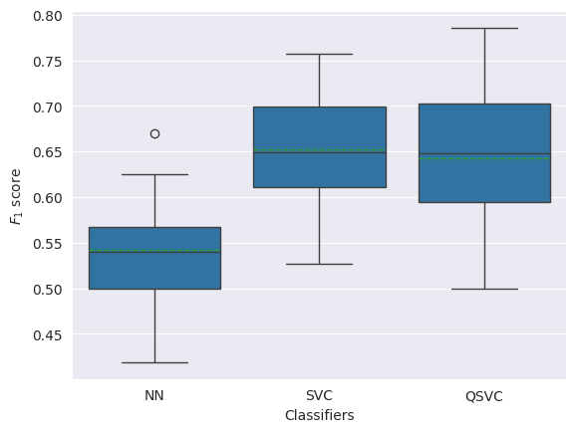
Experiments
Split the data into Train/validation/test with 0.6/0.2/0.2 proportions.
Trained a neural network on the data with 5 embedding layers and 1 classification layer.
Performed five-fold cross validation with early stopping criterion.
Obtained 8-dimensional embeddings and performed SVC and QSVC on the test data.
Ran QSVC on statevector simulator with two reps in the circuit.
Similar performance between SVC and QSVC.

Slide 9
Next Steps
Play with the hyperparameters in QSVC and SVC.
Change the number of embeddings.
Try it on hardware.
Implement Error Mitigation
Implement different encodings - FU
Optimize QSVC or VQC? - HD
Implement VQC or more sophisticated QML.
Try to classify Phases 1 and 2, or, 2 and 3, etc.
Try PegasosQSVC, QNN

